Slide 1


POLLIFY ONLINE VOTING SYSTEM USING MERN
Department of Information Technology
V R Siddhartha Engineering College
MERN Stack Web Development
B.Tech in Information Technology
INDUSTRIAL - RESEARCH INTERNSHIP 23-24 Review Presentation
Presented by
Motamarri Jaya Naga Venkata Sai ( 208W1A12A0 )
Under the guidance of
Mr. N Ravi Siva Ram Teja – Full Stack Developer, Codegnan IT Solutions Pvt Ltd.

Slide 2
AGENDA
Problem Statement
Architecture diagram
Proposed Method
Datasets and other Requirements
Implementation
Certificate
Presentation

Slide 3
Problem Statement
Is there any system that should address the challenges of traditional voting methods and ensure the integrity of the voting process while promoting transparency and convenience?
Security, accessibility, and compliance with legal regulations are paramount in delivering any trusted platform for conducting elections.

Slide 4
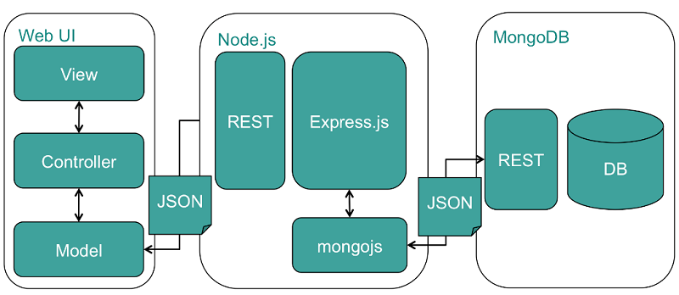
Architecture/Flow Diagram
Flow diagram for Online Voting System

Slide 5
Proposed Method
Identify the specific functionalities needed, including user registration, candidate profiles, vote casting, result calculation, and real-time updates.
A MongoDB database schema will be designed to store and manage voter information.
Implementing the backend using Node.js and Express, data processing, and integrating security measures such as user authentication, encryption, and input validation.
The frontend interface will be created using React.js, providing a user-friendly platform for voters to register, view candidates, and cast their votes electronically.
Thorough testing methodologies, including unit tests, integration tests, and end-to-end tests, will be employed to ensure the system's reliability and functionality.
Deployment on popular hosting platforms like AWS or render will enable widespread accessibility.

Slide 6
Dataset and Other Requirements
Software requirements of the project
- Windows 7 to 11
- Node JS , npm should be installed in the system.
- Install Vs code editor
- Technologies used: React JS , Express JS and Node JS Frameworks, Mongo DB Atlas.
Hardware requirements of the project
- 8GB RAM
- Minimum i5 processor

Slide 7
Implementation
Design the Database Schema : Determine the data structure for storing information about voters(users) and for votes(polls). Use MongoDB as your database to store this information.
Set Up the Backend : Create a backend server using Node.js and Express.js. This server will handle API requests and interact with the database.
Implement Authentication : Add user authentication to ensure that only registered voters can participate in the voting process.
Create the Frontend : Build the front end using React.js. Design the user interface to allow voters to register, view candidates, participate in elections, and submit their votes.
Connect Backend and Frontend : Establish communication between the frontend and backend by making API requests.
Test and Debug : Perform unit tests, integration tests, and end-to-end tests to identify and fix any issues.
Deploy the Application : Choose a suitable hosting provider such as AWS or Render and deploy your application to a production environment.

Slide 8
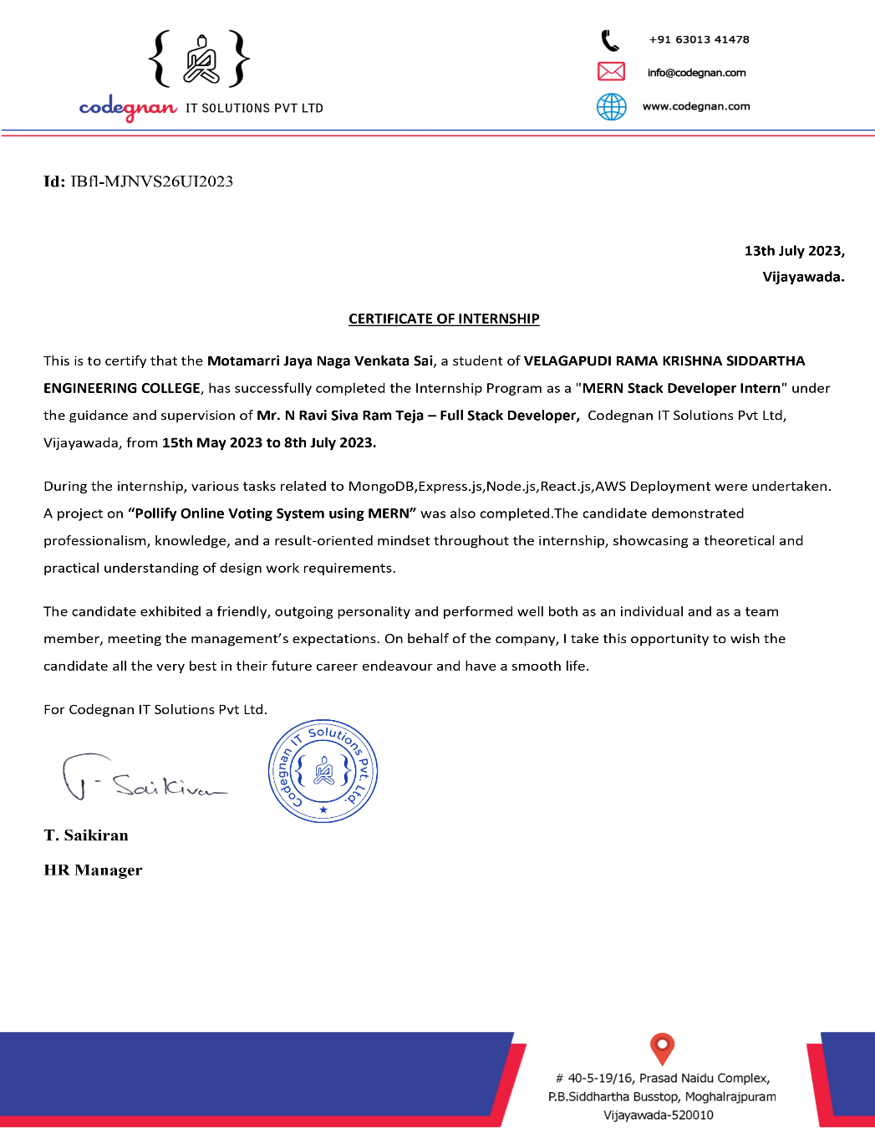
Certificate

Slide 9
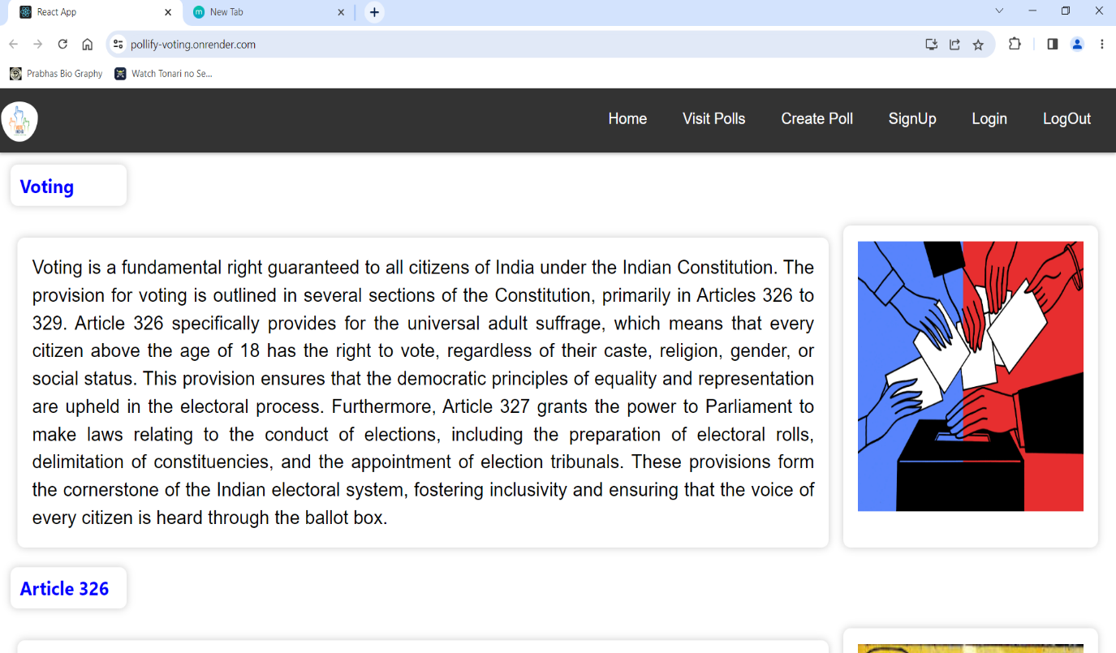
Home Page
Presentation
When You Click on “ Home Button “ Again You Will Be Re-Directed to The Website Home Page Only.

Slide 10
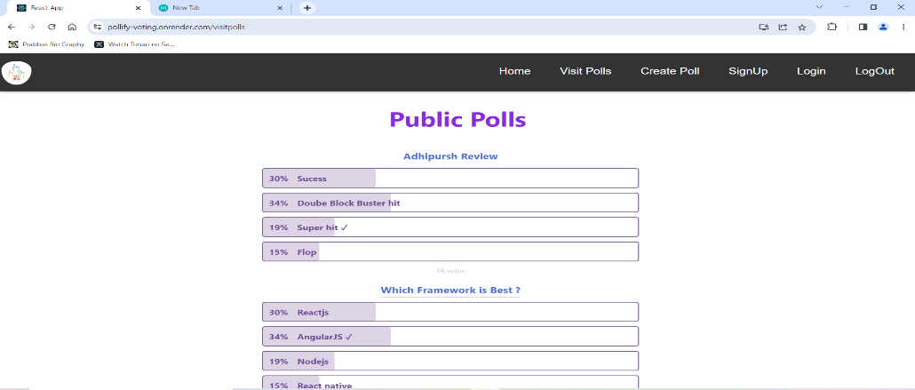
Visit polls Panel (Answered)
Here initially you can see unanswered poll and you can able to cast vote here.

Slide 11
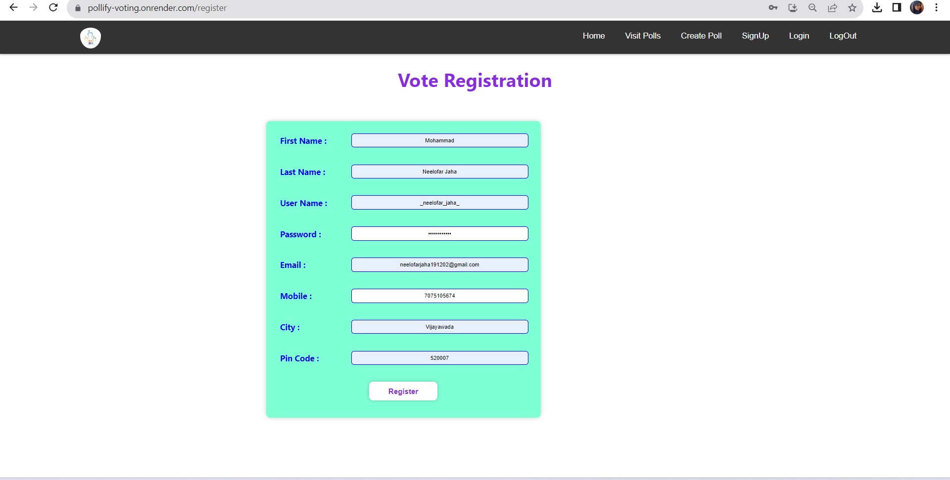
Registration form
On Successful of Voter Registration , You will be Automatically Re – Directed To The Home Page.

Slide 12
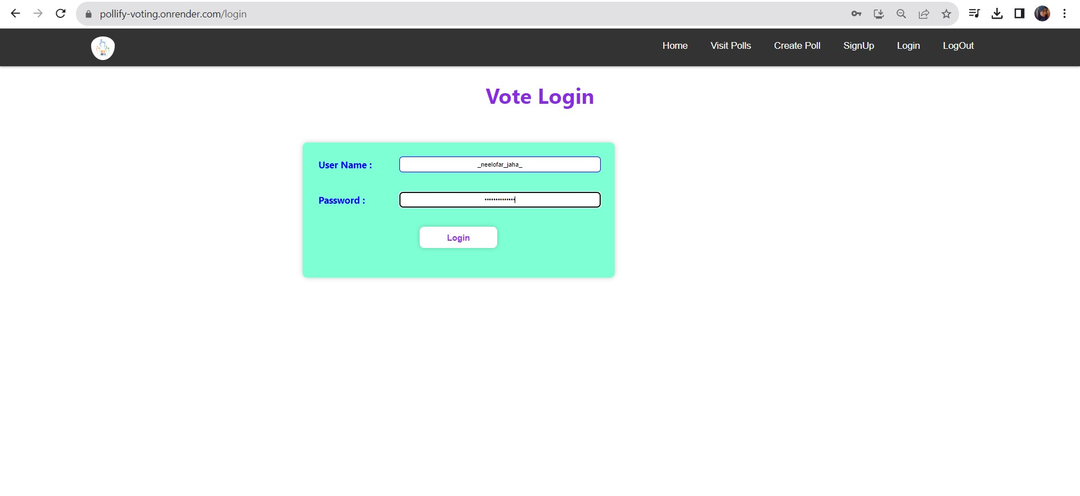
User Login Page
After Registration, Login of user Details You Will Be Re – Directed To The Website Home page.

Slide 13
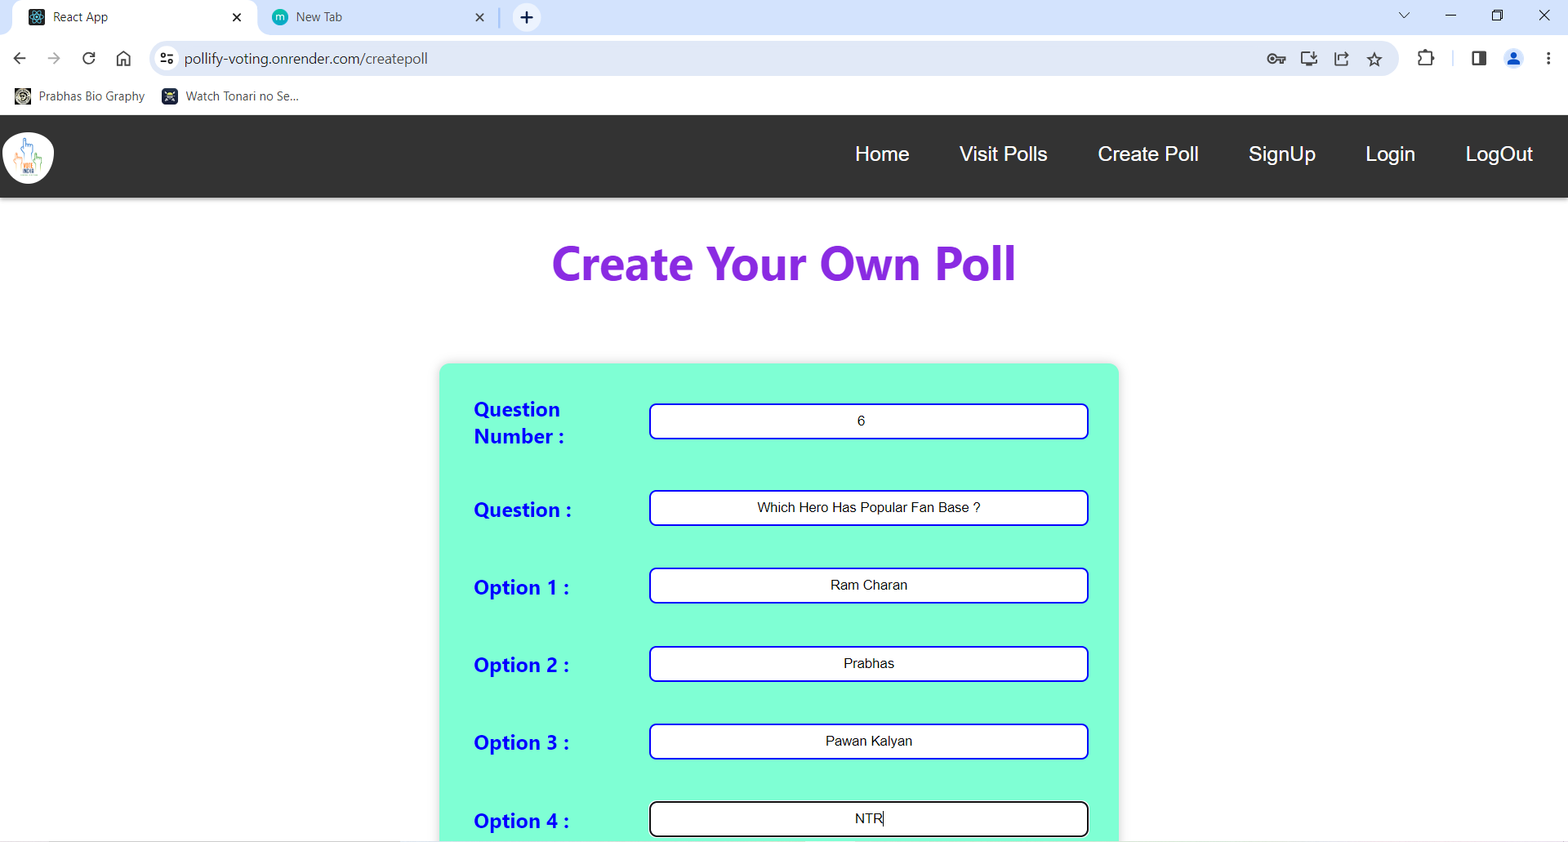
Create poll page
After creating poll, You Can Navigate to Public Polls Page for seeing and getting insights from that poll

Slide 14
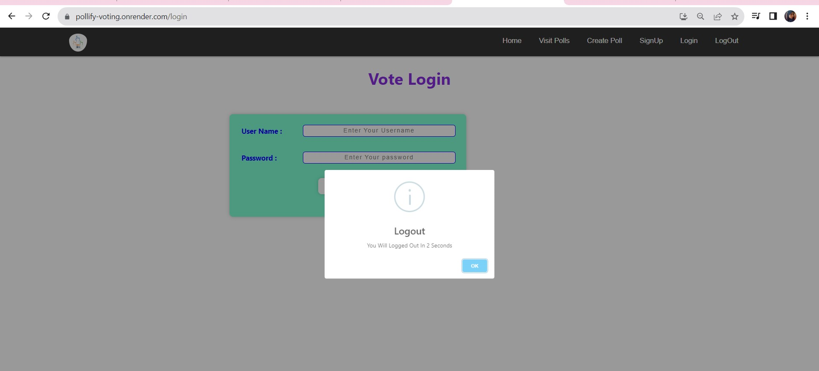
Log out page
After Clicking logout , you will get a pop up and then click ok to logout.

Slide 15


